Slide 1
Occupational Specialist Component Content: Digital Production, Design and Development
The T Level T Level Technical Qualification in Digital: Digital Production, Design and Development includes a single Occupational Specialist Component. Therefore, there is a single synoptic assessment for the Occupational Specialist Component, which is an extended ‘design, development and implementation’ project. The synoptic element of the project is important in order to ensure that students are able to demonstrate threshold competence: this is the principal reason why the Occupational Specialism is assessed via a single extended project assessment to ensure that students are able to evidence all the skills required by the Performance Outcomes.
The T Level Technical Qualification in Digital: Digital Production, Design and Development Occupational Specialist Component consists of several activities grouped into four substantive tasks.
Each task will be completed during a window set by Pearson during which you will schedule supervised assessment sessions. In some cases, tasks will also involve opportunities for unsupervised activities where the requirements of the skills being assessed make this necessary.

Slide 2
The unit outcomes
1.6 Understand how to identify and be able to address personal training needs that can boost job performance during the software development process.
Considerations to ensure the software developer is able to complete the required solution:
identify what further knowledge is needed.
identify what new skills are needed.
determine if software developer has the ability needed to complete the required solution.
Use different methods to address personal training needs required to enable completion of project:
undertake coaching from a professional or peer.
learn new skills on the job.
carry out self-study.
use online professional forums.
sign up to internet workshops for additional training.

Slide 3
Application of professional development planning (PDP)

Slide 4
Learning Objectives
Aims:
To introduce personal development plans
Objectives:
To be able to define and implement a personal development plan.
Notes:
Application of professional development planning (PDP)

Slide 5
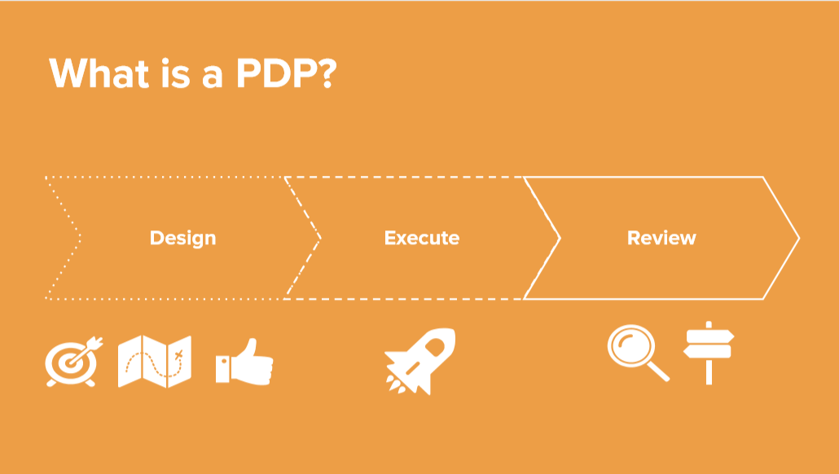
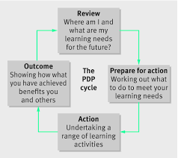
What is a PDP?
It is a plan designed to achieve your personal and professional goals considering a priority.
It is a plan based on the “HOW” and the tools to use.
It is NOT a career plan oriented to progress on a hierarchy or salary related.

Slide 6

Identify your goal/s
Your goal will be different depending on different factors, such as: previous professional experience, personal experiences, professional challenges, etc.
An easy way to classify them would be the division in these three groups:
Improvement or consolidation of the performance in your current job position
Improvement or inclusion of soft skills
Support the progression of your professional career with new skills

Slide 7

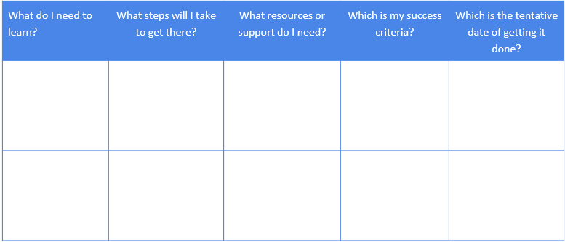
Identify the learning areas
We need to select and define a set of learning areas to help us achieve our selected goal/s.
We will use a template to document it, it can be a digital document or it can be the last page of your favourite notebook, there are no boundaries.
The ideal learning areas would be related with the behaviour, although we can include some technical ones, especially within the IT world.
Some examples...
Communication
Negotiation
Speaking in front of an audience
Coaching
Assertiveness
Getting technical certifications
Work methodologies
Specific technologies

Slide 8

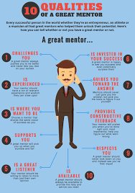
Validate your PDP
There are plenty of people ready to have a coffee with you and help you or support you.
Take a risk and ask around! They can be people from your job or not depending on the learning areas selected.
It is a win-win, as you will be reinforcing some of their soft skills by asking them to help you.
It is suggested you find a maximum of 2 or 3 mentors so you do not get overwhelmed by their different points of view.
Ideally each one of them would cover different learning areas, so you can have all of it covered.
You should find out the following information from your mentors:
Availability for future reviews.
Learning areas they will help you with.

Slide 9
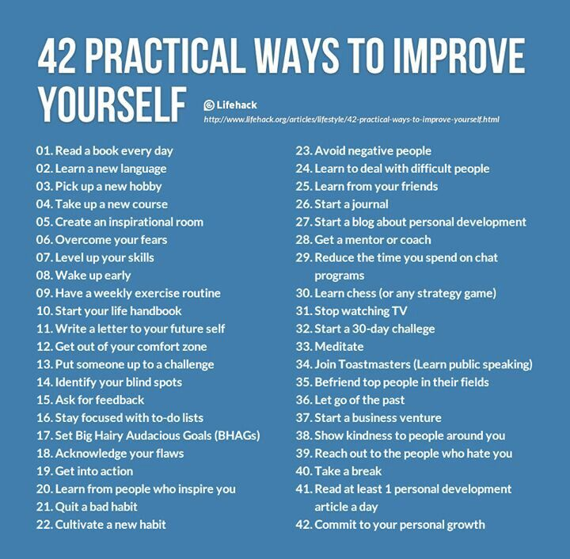
Execute – personal Development
These are the actions you can do by yourself to work on the learning area. Some examples are:
Research of information: reading, media, exploration.
Observation of the colleagues with more experience in the area you are trying to maximize.
Creation of a personal diary where you write your notes, discoveries, challenges and achievements. Be constant.

Slide 10

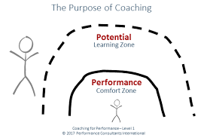
Execute – Coaching
It will require the time of your colleagues, mentors included, so make sure the sessions are productive.
Plan them and have a clear agenda.
Involve them in your actions, so you can get a feedback, inspect it and decide new actions.
You must review the PDP template periodically with them to make the most of it.

Slide 11
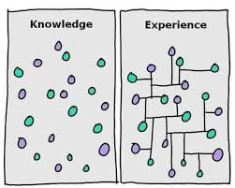
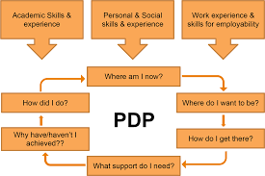
Execute - Experience
The most efficient way to improve your learning areas results consists on having a “hands on” attitude. Take part on tasks that are out of your comfort zone and that are oriented to your goals.
Decide, with your mentors, a small non-critical project you can execute, where you can put into practice the skills you are trying to improve or achieve.
Create your own new learning or knowledge opportunities, observe your environment and come up with new actions.

Slide 12
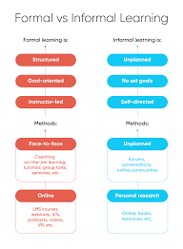
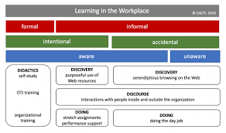
Execute - Formal Training
If the other 3 options were not enough to reach the level of experience you want to acquire in any of the learning areas of your PDP, you can consider a more formal training.
Manage the possible options with your mentor or manager if we are talking about professional scope.
Ask around about similar trainings people may have taken previously and get their feedback.
Notes:
I

Slide 13

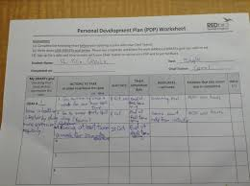
Review
A PDP is a tool you can use every time you consider it is necessary, you can actually use it permanently.
In the review you may find you reached your goal and add a new one, or you may adapt including new actions to help you reach your goal in the next iteration.
“Plans are useless, but planning is indispensable” - Eisenhower

Slide 14
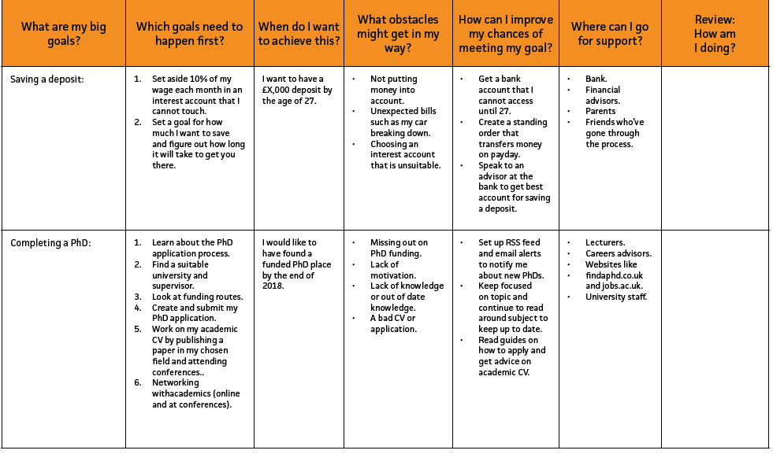
Activity -Writing a Personal Development Plan
So if you haven’t considered where you want to go or if you’ve ever thought that a five-year plan isn’t for you, now is the time to start thinking about who and where you want to be in your future.
There are seven steps to writing a PDP:
Set yourself goals.
Prioritize those goals.
Set yourself deadlines for when you want to achieve them.
Recognize threats and opportunities.
Develop your skills or increase your knowledge.
Use your support network.
Measure your progress.

